Slide 1

Predictive analytics for customer churn prediction

Slide 2
Introduction
Customer Churn prediction means knowing which customers are likely to leave or unsubscribe from your service.
Customers have different behaviors and preferences, and reasons for cancelling their subscriptions like:
Availability of latest technology
Customer –friendly bank staff
Low interest rates
Location
Service offered
It is important to actively communicate with each of them to keep them on your customer list. You need to know which marketing activities are most effective for individual customers and when they are most effective.

Slide 3
Business Problem
Customer churn posses a significant challenge in the banking industry, as it leads to financial losses and negatively impacts the bank’s reputation.
A company with a high churn rate loses many subscribers, resulting in lower growth rates and a greater impact on sales and profits.
It is crucial to predict and understand when customers might decide to end their relationship with the bank.

Slide 4
Customer churn model
Prediction models are used to identify customers who are likely to churn
The model uses historical data on former churners and tries to find some similarity with existing customers
If some similarity is found those customers are classified as potential churners

Slide 5
Why is this important for the bank
The cost of acquire new customers can be more than holding on to an existing customers
Long term customers become less costly to serve, they generate higher profits, and they may also provide new referrals

Slide 6
Benefits of Analyzing Customer Churn Prediction
Increase profits
Improve the customer experience
Optimize your products and services
Customer retention

Slide 7
Data Source
The dataset used for this project was obtained from Kaggle, specifically the “Bank Customer Churn” dataset, which can be accessed at (https://www.kaggle.com/datasets/radheshyamkollipara/bank-customer-churn). This dataset contains information on bank customers, including transaction history, demographics, account activity, and customer interactions, and other relevant features. The dataset comprises 10,000 rows and 18 columns.

Slide 8
Data Preparation
Data preparation includes the following processes:
Checking for data duplication. The result is that there are no duplicate data
Checking for missing values. There are no missing values in this data
Feature Engineering, extracting age group features, and transforming the data into the desired form.
Encoding, converting categorical data into numerical. The encoding method used in this case is ordinal encoding.

Slide 9
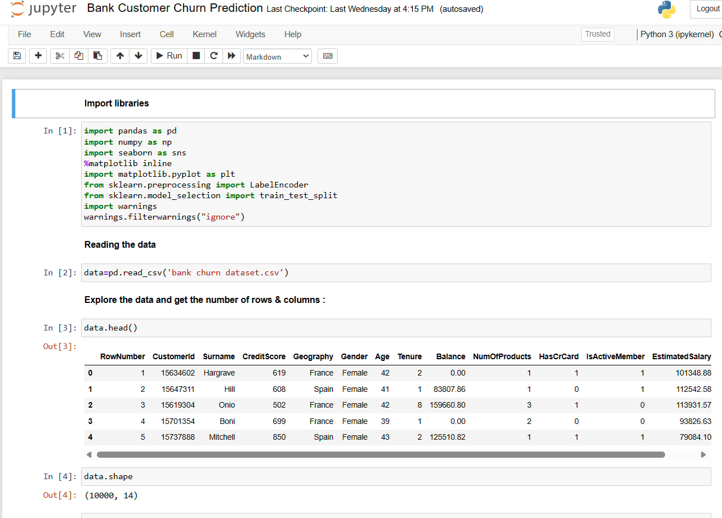
Data Analysis

Slide 10
Business Insights
Female bank customers churn the most with a percentage of 11.4% compared to males who have a percentage of 9%.
Bank customers in the 40–50 age group have a higher churn percentage than other age groups
Random Forest Classifier is best fitted which gives accuracy score 86.95%.

Slide 11


